Slide 1







RAJASTHAN POLICE HACKATHON 1.0

Slide 2



DARK WEB MONITORING
Team :- S.A.L.T ChangeMakers
Team Members :- Sandeep Yogi(Leader)
Lokesh kumar
Tanvi jain

Slide 3

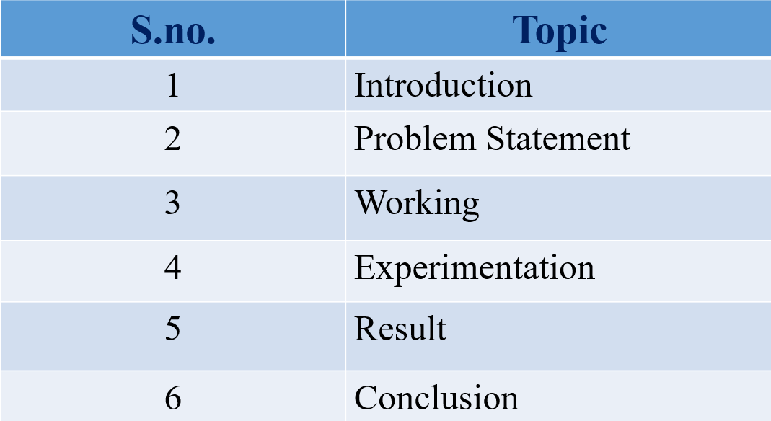

INDEX

Slide 4
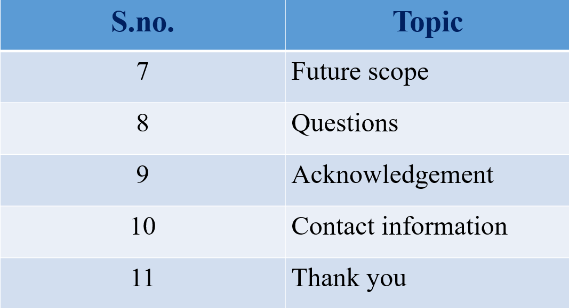

Slide 5


Introduction
Dark web monitoring is a cybersecurity practice that involves monitoring the dark web for any information related to your organization. This could include leaked credentials, sensitive information, or discussions about potential attacks. There are companies that specialize in dark web monitoring and can provide this service for your organization. It's an important part of a comprehensive cybersecurity strategy, as it allows you to proactively identify and respond to potential threats.

Slide 6

Problem Statement
In today's digital age, with the increasing number of data breaches and cyber-attacks, organizations are facing a significant challenge in protecting their sensitive information. Much of this information often ends up on the dark web, where it can be bought, sold, or traded by malicious actors. The challenge is to develop a solution that can effectively monitor the dark web for any information related to an organization, such as leaked credentials, sensitive information, or discussions about potential attacks. This solution should provide real-time alerts and comprehensive reports to help organizations proactively identify and respond to potential threats."

Slide 7

Find Onion Link:
Security:
Vulnerabilities:
Finding .onion links can be challenging, as these links are not indexed by traditional search engines like Google or Bing.
The dark web can pose significant security risks to individuals and organizations alike, as it is often used by cybercriminals to buy, sell, or trade stolen data, malware, and other illicit goods and services.
Finding vulnerabilities in .onion links can be challenging, as these sites are often designed to be as secure as possible.

Slide 8
Data Extraction:
Data extraction from an .onion link involves the process of collecting information from a dark web site. This could include scraping user posts, product listings, chat logs, or any other information that can provide insights into potential threats or malicious activities. The goal of data extraction is to gather as much relevant information as possible, which can then be used for various purposes such as threat intelligence, dark web monitoring, or investigations.

Slide 9
Solution:
1. Find onion link:
find onion links for finding specific data on dark web.
2. Onion link scan:
help operators of hidden services find and fix operational security issues with
their services.
help researchers and investigators monitor and track Dark Web sites.
3. Data crawling:
Gain specific data from the Dark web and store that data in the data database.
4. Security breaches:
Find security breaches on dark web for particular specific company, military,
university, etc.
5. Real-time monitoring:
provide real-time monitoring of dark web
6. Secure sensitive information:
Finding sensitive information of victim that is available on dark web secure .

Slide 10
Software and Technology:
1. Programming Languages:
Python
2. Frameworks:
Web crawlers, Data analysis, Machine learning, anomaly detection, OSINT, tor network monitoring, etc
3. Tools:
Tor, VPN
4. Python Libraries:
Tkinter, datetime, pypdf2, cv2, pytesseract, re, mysql, urllib. request, bs4, etc.

Slide 11
Working:
This project provide 2 type of methodology:-
1. Manual
2. Automation
1. Manual:- In manual, user do every task manually by giving input of urls each and every after taking url from the found urls.Manual work on only 1 url at a time, after complete data extraction you provide another url.
2. Automation:- In automation, user only need to provide query after taking query found urls and extract data of all urls at a time . Autmation work on multiple urls at a time .

Slide 12

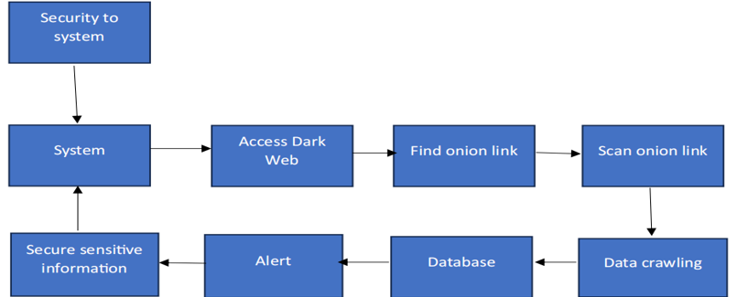

Flow Chart / Graphical Representation:
Analytical techniques for securing system
Finding weakness of system and gaining excess in the system by exploiting those weakness is known as hacking. While doing hacking attacker always make our system anonymous, if attacker doesn’t do so then any ethical hacker catch attacker. Attacker also wanted that victim doesn’t about the hacking.
By using the three level security method we can enhance the security.

Slide 13
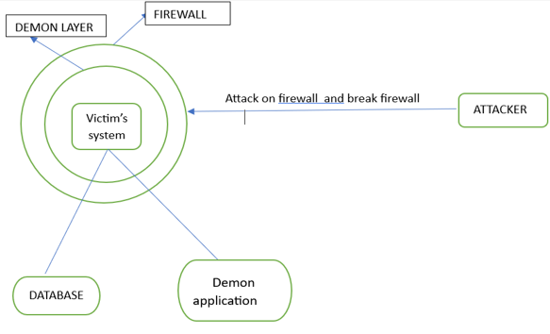
Level 1: If any hacker attack on system, then demon frame work denied the permission to accessing the victim’s system. First layer of firewall security provides the service to protect system from general hackers.
Figure 1: Firewall protection
Problem: But if profession hacker bypass this level 1 and enter in the level 2 and trying to established the network connection with the victim system by using the ping packet transmission for hacking purpose.

Slide 14
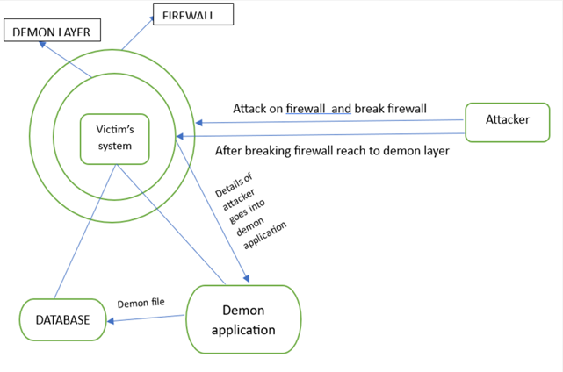
Level 2: In this level Damon framework will alert for the hacker’s activity. The Damon framework get the information about the attacker.
Figure 2: Getting attackers information
Problem: Now the Damon framework identify the source of the ping packets. Then Damon framework declared that the ping packets are send by the attacker side or not. If ping packets send by the attacker’s side then demon framework will send demon file in the database.
Now the working process of Damon file will performed in the level 3.

Slide 15
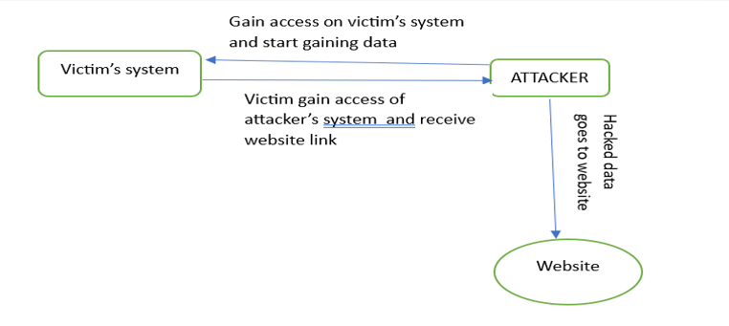
Level 3: First of all hacker’s start getting the data file from victim’s database system. In this working process the hacker never knows about the Demon file presence in the database. And Demon goes into attacker’s system and execute automatically. Victim gets access of attacker’s system and gain his data through website.
Figure 3: Getting access of attacker system
Other Securities:-
1. Intrusion detection system(IDS)
2. Intrusion prevention system(IPS)
3. Firewall
4. End point security

Slide 16
Access Dark Web:-
Accessing dark web is a very difficult task because user does not able to use dark web from normal browser. For accessing dark web user need special called tor .
For accessing onion links we use tor proxy using python script .
Find onion link:-
Finding onion link for a specific qeuery is a challenging task for dark web user.
For finding onion we create script and when we pass query in the input script provide bunch of onion links related to that querey in a file.
Data Extraction:-
Create a python script for extracting whole data of website include image,videos,text,etc. python script also provide html code of website which provide more data . This will provide all links present in the website.
Vulnerabilities:-
Create python script for scanning and finding possibile vulnerabilities like XSS, which help to exploit website and we able gain more information about the website .

Slide 17
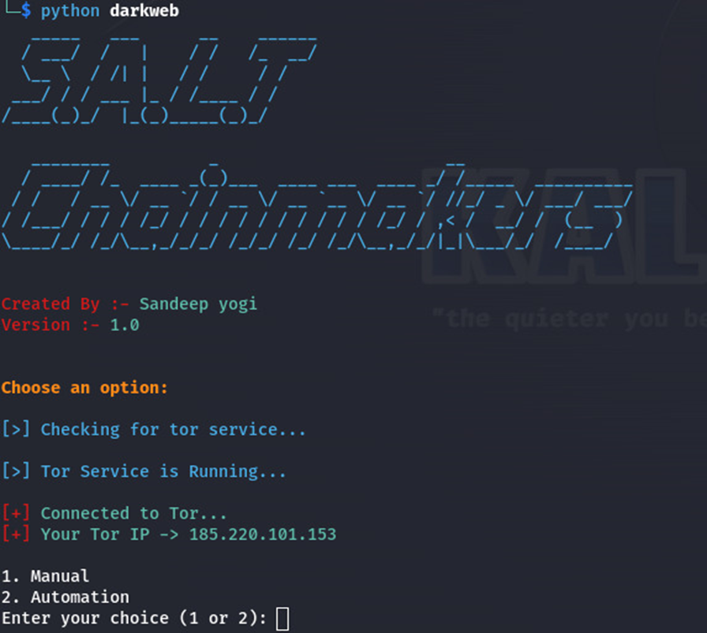
EXPERIMENTATION
This project provide 2 type of methodology:-
1. Manual
2. Automation

Slide 18
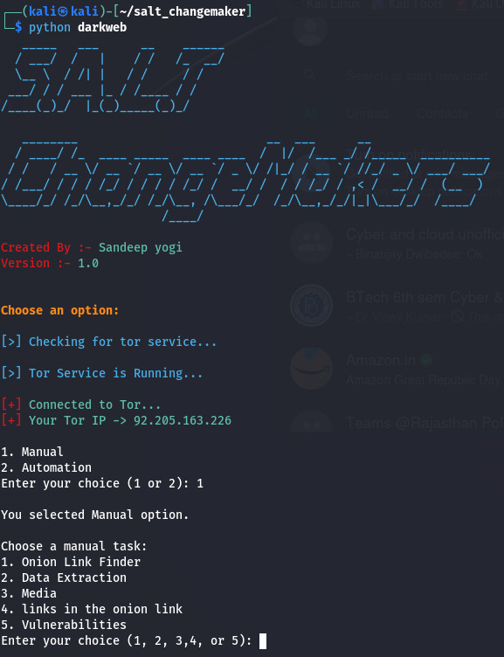
After choosing manual:-
You have 4 option which you want to do
1. Onion link finder
2. Data extraction
3. Media
4. Links in website
5. Vulnerabilities

Slide 19
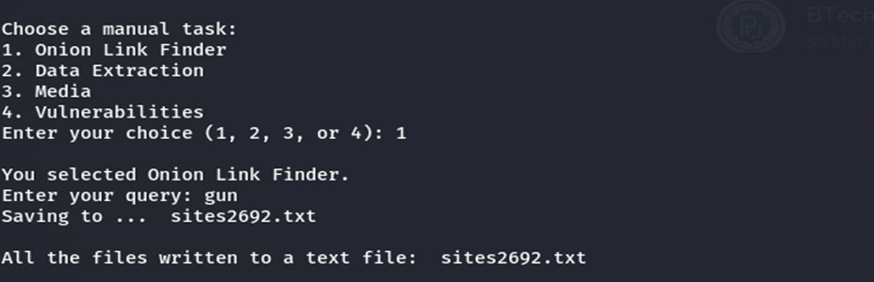
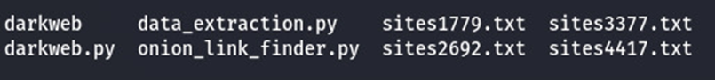
Onion link finder:-
python script helps to find bunch of onion links for a specific query and save all onion links in a file which is created by python script.
Img: screnshot of output
After submitting query onion links saved in file sites2692.txt
Img : screenshot of saved files of onion links file sites2692.txt

Slide 20
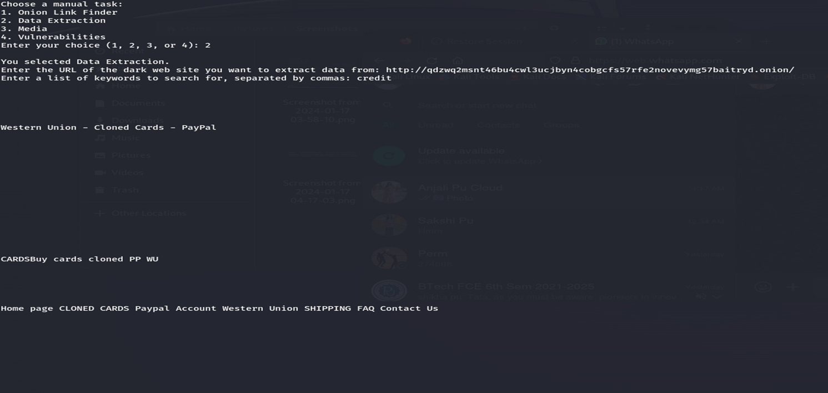
Data extraction:- After choosing data extraction you will need to provide url of the website in the input and also provide keyword you want to extract in the input .
Img 1 :- Data Extraction

Slide 21
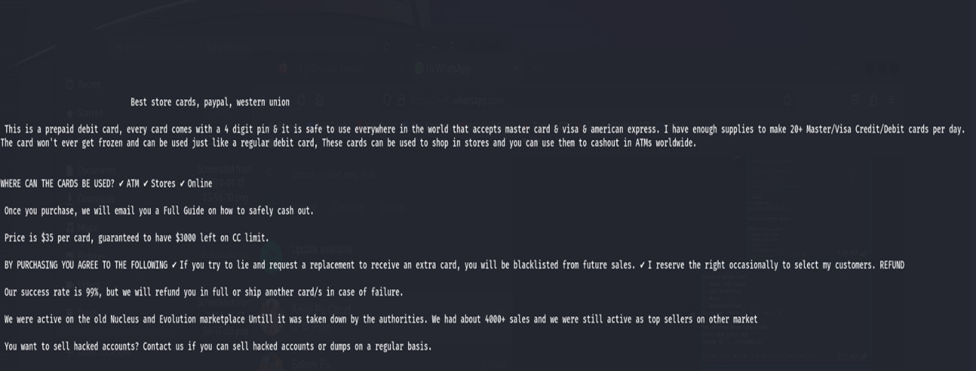
after providing input of url print script provide data of website like text ,html code ,etc
Img 2 :- Data Extraction

Slide 22
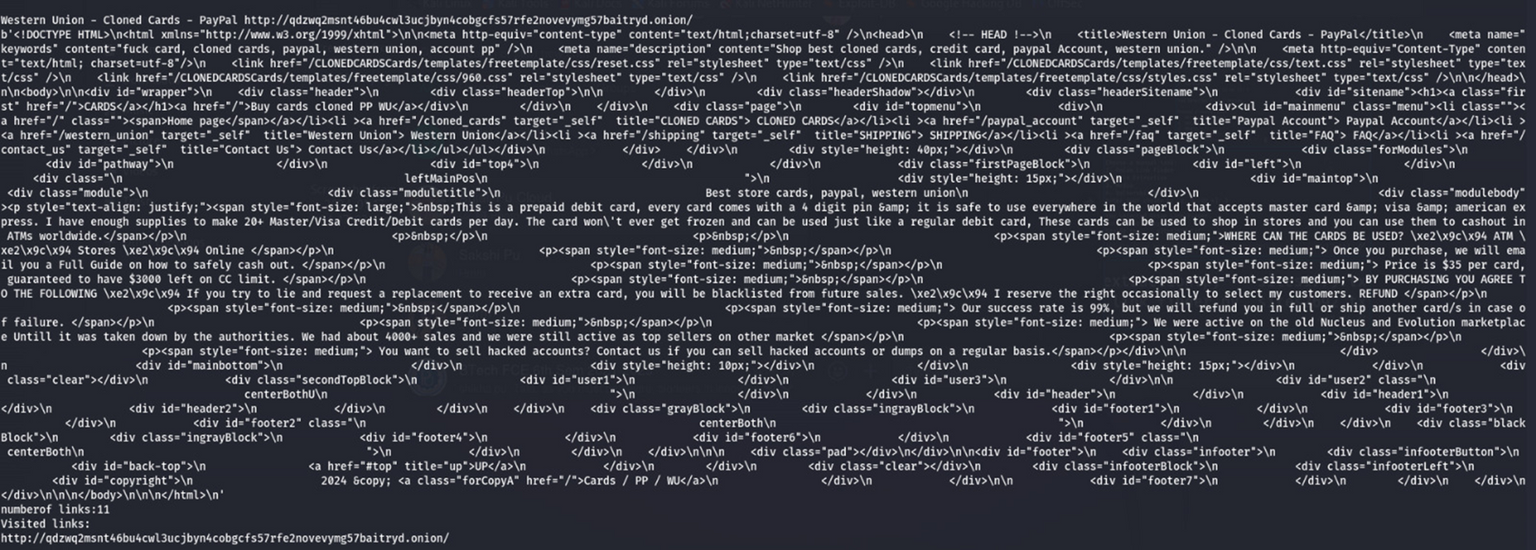
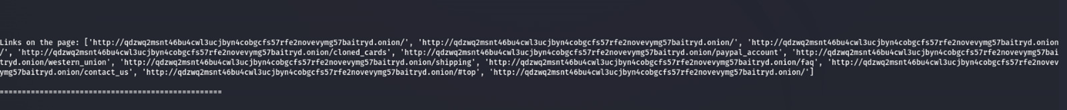
Img 3 :- Data Extraction
Img 4:- Data Extraction

Slide 23
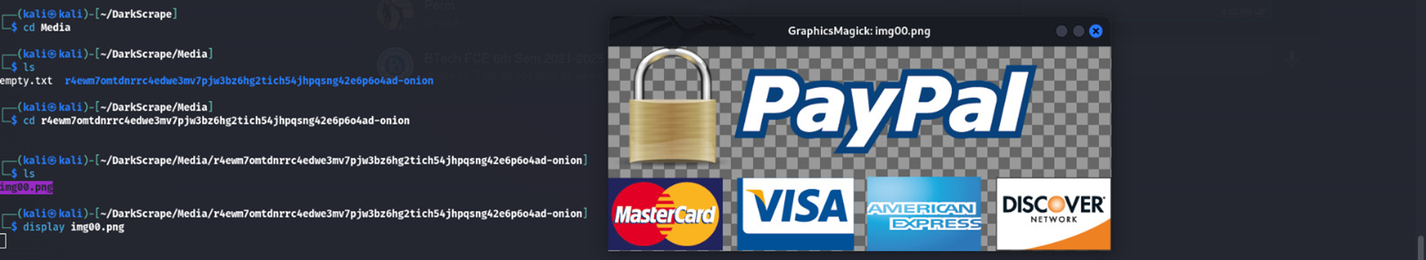
Media:- In it , it provide and dawonload image ,video present in the url. Image, video ,etc work as a proof and provide more information about url.python code save downloaded image in another directory and file after making directory and file.
Img: screenshot of media and show downloaded image that available on website.

Slide 24
Security:-
By using the three level security method we can enhance the security.
Level 1: If any hacker attack on system, then demon frame work denied the permission to accessing the vicitm’s system .First layer of firewall security provide the service to protect system from general hackers.
Problem: But if profession hacker bypass this level 1 and enter in the level 2 and trying to established the network connection with the victim system by using the ping packet transmission for hacking purpose.

Slide 25
{
"ListOfBannedIpAddr": ["192.168.43.181", "192.168.43.182"],
"ListOfBannedPorts": [80, 81],
"ListOfBannedPrefixes": ["172."],
"TimeThreshold": 10,
"PacketThreshold": 100,
"BlockPingAttacks”: "True"
}
Firewall blocked a proper port, prefixes, packet threshold attacks and block ping attacks.

Slide 26
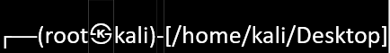
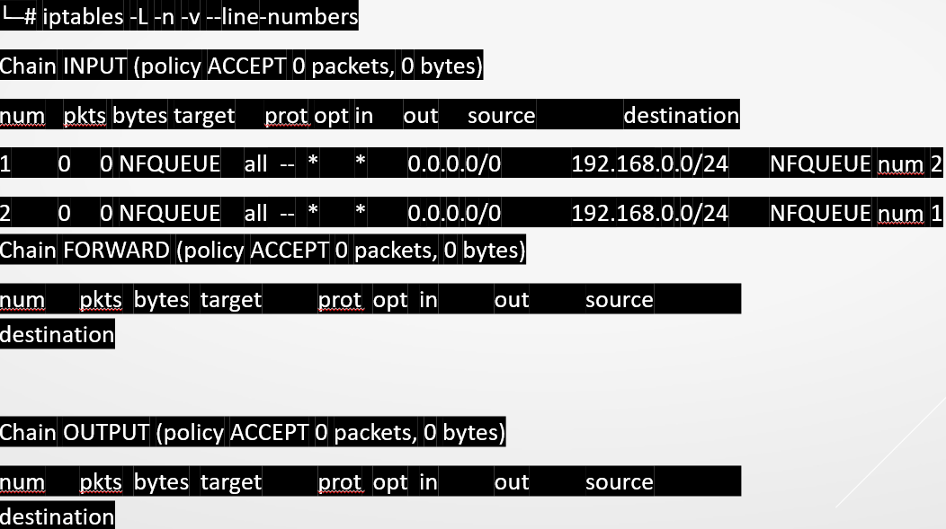
Firewall running status

Slide 27
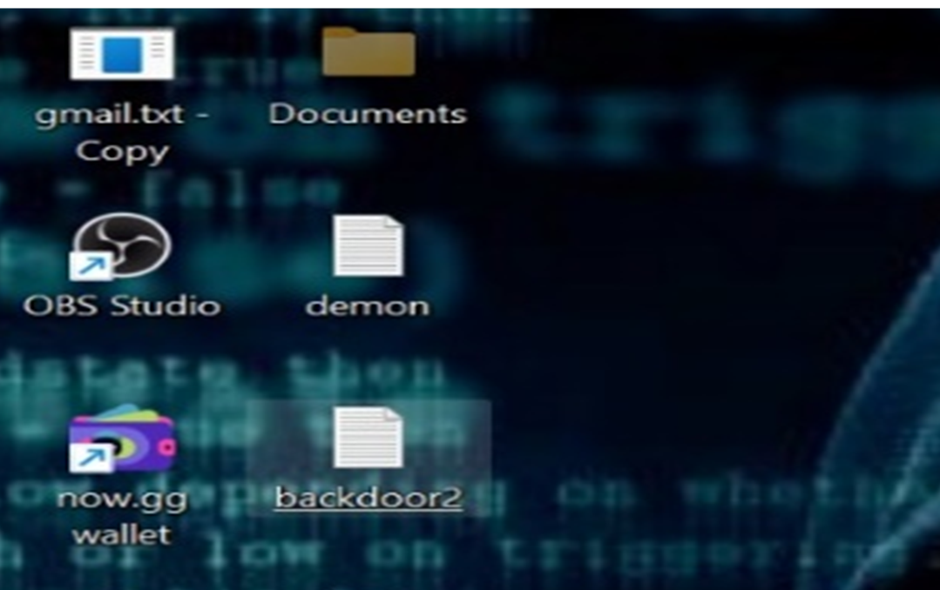
Level 2: If attacker break the firewall then second firewall just simply get the IP address of attacker and check the IP address is known or not , If not demon save the demon file in the database.
Screenshot 1: demon file

Slide 28
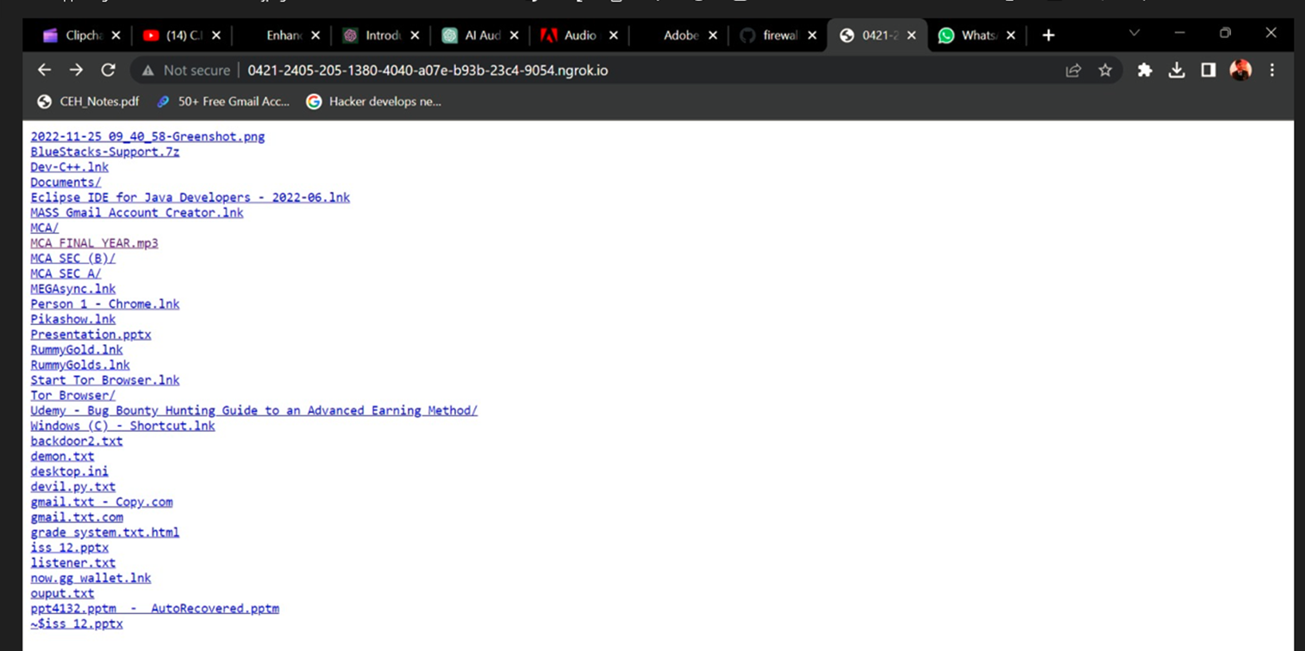
Level 3: When attacker start taking data from victim, demon file adjoin with other files and forward to attacker system. Then attacker file will run automatically on the system of attacker and send the link of website to the victim system.
Screenshot 2: web page screenshot

Slide 29
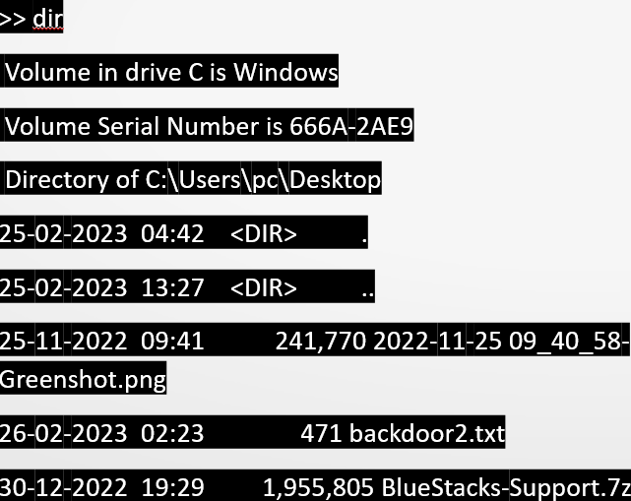
This web page contain the files of attacker system where demon file is saved. Demon file also give control to the victim of attacker system. And victim able to upload files, delete files, execute command, read file and write files.

Slide 30
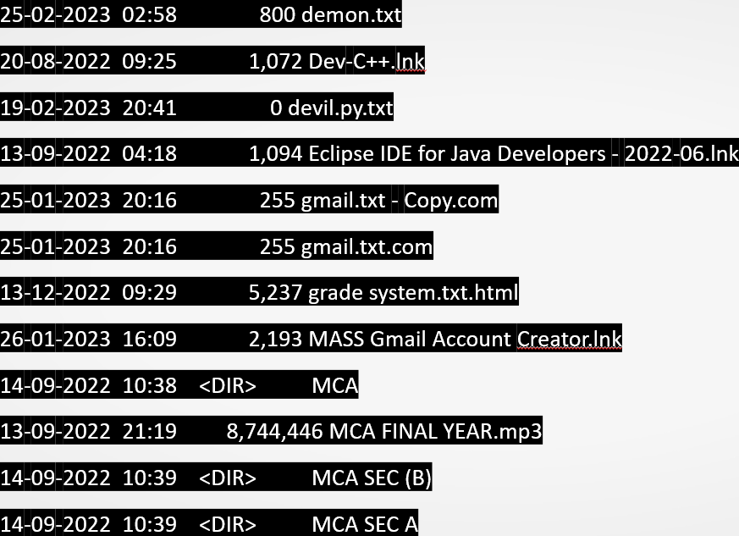

Slide 31
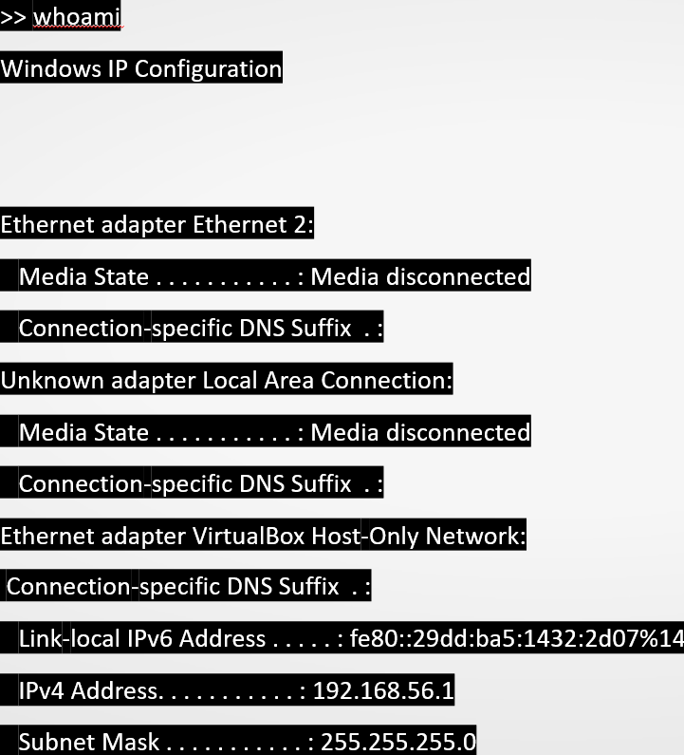
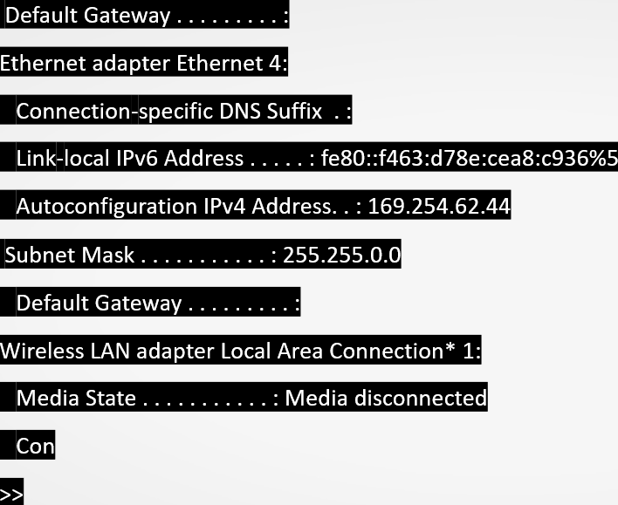

Slide 32
RESULT
1. By the use of this project, victim get bunch of onion links
2.Provide data of website and other links present in website .
3.Secure victim’s sensitive information or data from hacker by using different type of security.
4.This project download media of website and save in folder .
5.Demon provide all back from hacker’s system through website.
6.Victim able to get access to the hackers system when hacker gain data from victim’s system.
7.This project find vulnerability in the .onion website and provide html code of website.

Slide 33
Conclusion
Cyber forces able to find information about the .onion website.
Cyber forces able to identify the .onion website is offensive or defensive.
Educational institutions and students can use the project's outcomes to gain hands-on experience in the field of cyber security and machine learning.
Reduce the number of cyber crime happen on darkweb.
Cyber forces able to find gmail, contact information, etc . Which help cyber forces to find more information about .onion link.

Slide 34
Future Scope
Improve code quality of vulnerability finding and find more vulnerabilities in the website.
Any attack that will happen in future , the prevention from that can be updated in this software later for future usage.
Update code and find cyber criminals work on dark web.
Update code and improve automation system by which user easily use the software.
We can enhance the security with developing techniques in future.

Slide 35


Any Questions?

Slide 36

Thank You
Contact Information
Name:- Sandeep Yogi
Gmail:-2021btechcsbsandeep9797@poornima.edu.in
Contact no. :- 9351390295, 8441939422

